Slide 1
Multimodal AI System for Dermatology
with ABCDE Explainability and VQA
End-to-End Image–Text Fusion for Explainable Dermatology Decision Support
Presented by Akhil Kulal (M24CEIT001)
Under the guidance of Prof. Manasi Kulkarni

Slide 2
Introduction & Motivation
Skin cancer is one of the most common and dangerous cancers worldwide.
Early diagnosis relies on the ABCDE rule:
Asymmetry, Border, Color, Diameter, Evolution
Existing AI systems only focus on image-only classification
Clinical Diagnosis also depends on:
Patient History
Symptoms
Medical Reports
There is a strong need for
Explainable
Multimodal
Interactive AI systems for Dermatology

Slide 3
Problem Statement
Skin Cancer diagnosis is a complex clinical process requiring analysis of:
Visual inspection of skin lesions
Patient symptoms and medical history
Temporal changes in lesion appearence
The clinically accepted ABCDE rule is:
Time consuming and subjective
Dependent on expert interpretation
.Existing AI systems:
Primarily perform image-only classification
Do not explicitly compute or explain ABCDE criteria
Most systems lack:
Transparency in decision making
Interactive mechanism for follow-up clinical queries
This lead to limited trust, reduced interpretability, and restricted clinical usability of current AI tools

Slide 4
Literature Survey
Author & Year | Title of Paper | Model Used | Dataset Used | Insights gained | Limitations
Siyuan Yan , 2025 | A multimodal vision foundation model for clinical dermatology | ARCUNet | ISIC 2016, ISIC 2017, ISIC 2018, PH2 Dataset | Best-in-class skin lesion segmentation (SLS stage) | Limited interpretability in clinical field
Kuang et al., 2025 | R-LLaVA: Improving Med-VQA with Visual Regions of Interest | R-LLaVa | Medical VQA Datasets | Advanced multimodal VQA with RLHF | High computational cost, language fidelity
Borisma et al., 2023 | EfficientFormerV2: Optimized Transformer for Classification | EfficientFormerV2 | HAM10000, ISIC | Efficient, accurate hierarchical lesion classification | Handling class imbalance
Lee et al., 2020 | BioBERT: Pretrained Biomedical Language Representation | BioBERT | PubMed, PMC, MIMIC-III | Core biomedical NLP for report extraction | Limited entity diversity
Zhang et al., 2022 | BioGPT: Generative Pretrained Transformer for Biomedicine | PubMed abstracts | BioGPT | Clinical report summarization & generation | Need diverse fine-tuning

Slide 5
Literature Survey
Author & Year | Title of Paper | Model Used | Dataset Used | Insights gained | Limitations
Yi et al., 2025 | Multimodal medical image fusion with self-supervised learning | Self-supervised Fusion CNN | MIMIC Chest X-ray | Label-efficient medical image fusion | Generalizability and clinical validation
Wang & Yang, 2025 | MoE-Health: Mixture of Experts for Multimodal Healthcare Prediction | MoE-Health | MIMICIV | Robust fusion of diverse clinical data | Expert scaling, interpretability
OpenRLHF Team, 2025 | GRPO: Group Relative Policy Optimization | GRPO | Synthetic/EHR data | Efficient RLHF training for VQA models | Computation overhead
PaddlePaddle Team, 2021 | PaddleOCR + BioBERT for Medical Documents | PaddleOCR + BioBERT | Public OCR datasets | Accurate OCR and NLP for clinical report pipeline | Issues with handwriting and noisy docs
Huang et al., 2025 | Leveraging segmentation maps to improve skin lesion classification | Transformer with segmentation fusion | ISIC, PH2 dermatology images | Enhances HC via segmentation-classification integration | Computational overhead

Slide 6
Research Gap
Despite advances in deep learning and medical AI:
Multimodal data (images + medical reports + symptoms) are rarely fused in a single system
ABCDE criteria are often:
Used implicitly
Not computed as explicit, explainable features
Most dermatology AI systems:
Stop at classification
Do not support clinical reasoning or dialogue
Medical Visual Question Answering (VQA):
Exists independently
Is not grounded in structural clinical features like ABCDE
There is a lack of:
End -to-end deployable systems
Patient centric conversational dermatology assistants

Slide 7
Objective
Automate skin lesion segmentation and classification
Extract ABCDE values for explainability.
Process medical reports and symptoms using NLP.
Fuse image + text → Unified clinical Representation (JSON output).
Enable (Virtual Q)VQA for clinicians/patients.

Slide 8
Scope of the Project
End-to-end AI pipeline
Image + Text + Interactive Q&A
Supports
Dermoscopic images
Clinical images
Medical Reports (PDF/Text)
Provides:
Risk assessment
Explainable ABCDE output
Designed as a clinical decision-support system, not a replacement for doctors.

Slide 9
Methodology Overview
Stage 1: Preprocessing
Stage 2: Skin Lesion Segmentation (SLS)
Stage 3: ROI Cropping (SLRC)
Stage 4: Hierarchical Classification (HC + ABCDE)
Stage 5: Medical Report Processing (MedProc)
Stage 6: IT Fusion
Stage 7: Visual Question Answering (VQA)

Slide 10
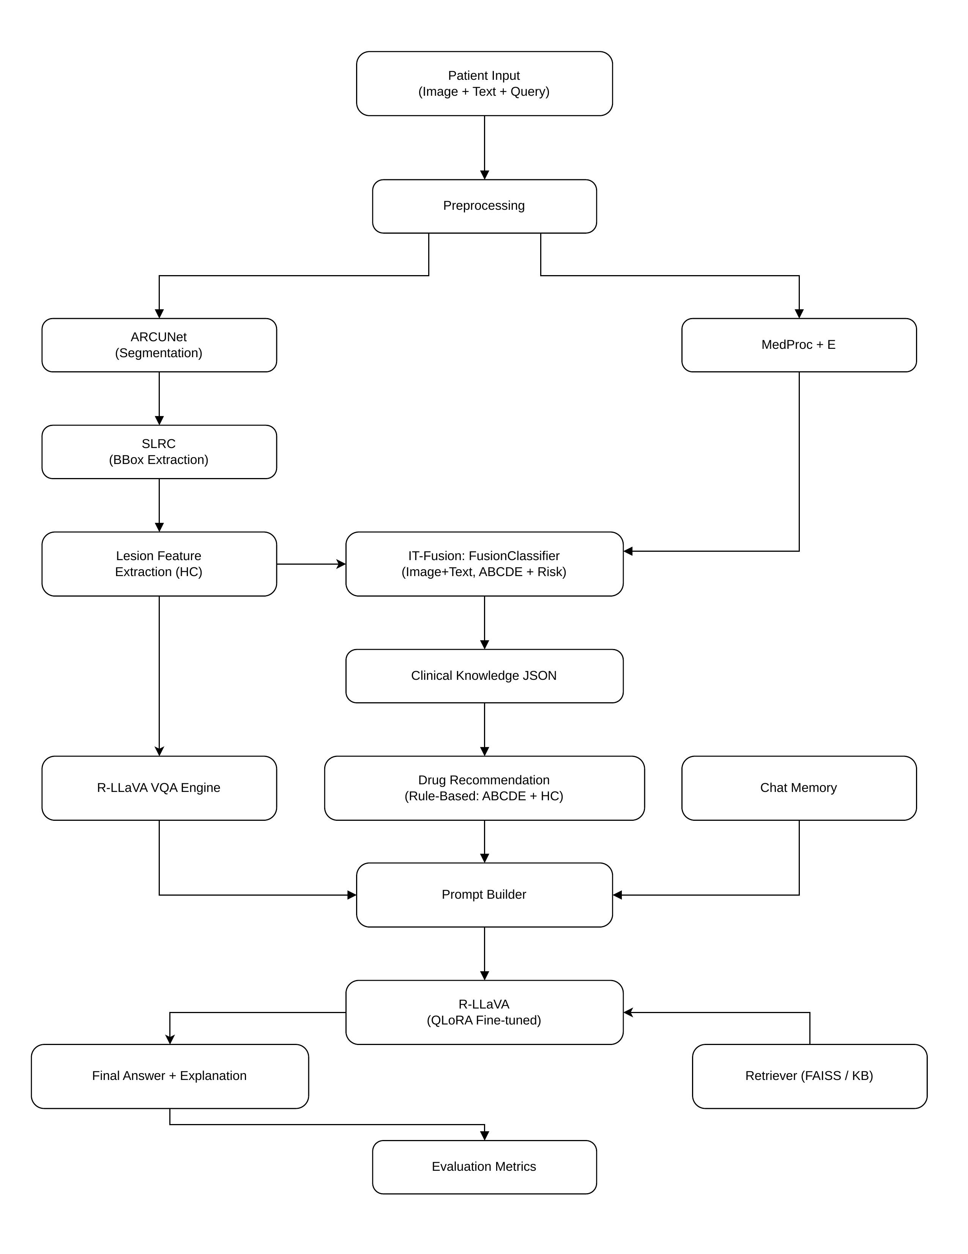
System Architecture Diagram

Slide 11
System Architecture
Frontend: React-based chatbot for patient interaction.
Backend: FastAPI orchestrating AI models.
Stages: SLS, SLRC, HC, MedProc, IT Fusion, VQA.
Outputs: Classification + ABCDE + Q&A answers.

Slide 12
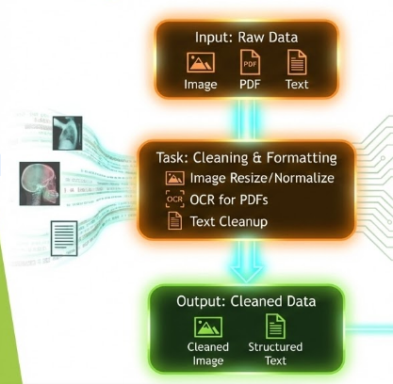
Stages of Project I – Preprocessing
Methods | Image resizing, normalization, hair removal, OCR, tokenization.
Models | PaddleOCR (PDF->OCR)
Input | Skin Image(any size), Medical PDF / Unstructured text
Output | Resized image (as per required), Structured text

Slide 13
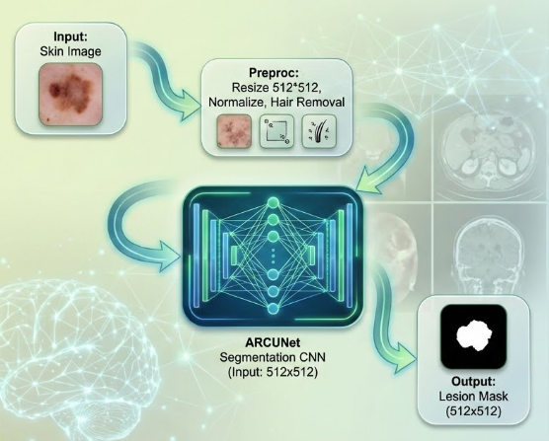
Stages of Project II – Skin Lesion Segmentation(SLS)
Model | ARCUNet
Input | Skin image(512*512)
Output | Binary Lesion Mask (512*512)
Evaluation Metrics | Dice Coefficient: 0.8506 IoU (Jaccard): 0.7718 Boundary F1: 0.8815 | Pixel Acc: 93.7%
Task Performed | Convert the RGB Skin lesion to B/W image such that only lesion part is white colour
Paper | https://www.ncbi.nlm.nih.gov/pmc/articles/PMC11920274/

Slide 14
SLS (Skin Lesion Segmentation) - Experimental Setup
Two Segmentation Strategies used for SLS stage:
Mini Batch Training:
Batch SIze 2870 samples
Faster Convergence
Lower memory requirement
Full Batch Training
Entire segmentation dataset used per epoch
More stable gradient estimation
Higher computational cost
Purpose:
To analyze the trade-off between training efficiency and segmentation quality

Slide 15
SLS (Skin Lesion Segmentation) - Qualitative Segmentation Results - Mini Batch Training
Observations (Mini-Batch Model)
Lesion regions are partially detected
Predictions appear
Blurred
Fragmented
Inconsistent at lesion boundaries
Small or low-contrast lesions are often:
Missed
Under-segmented
Quantitative Indicators
Low Dice and Jaccard scores for several samples
High variance across different images
Interpretation
Mini-batch training captures coarse lesion features
Insufficient exposure to full data distribution leads to:
Poor generalization
Weak boundary learning

Slide 16
SLS (Skin Lesion Segmentation) - Qualitative Segmentation Results - Full Dataset Training
Observations (Full Dataset Model)
Lesion shapes are:
More complete
Better aligned with ground truth
Clear improvement in:
Boundary precision
Shape consistency
Large and irregular lesions are segmented irregularly
Quantitative Indicators
Significantly Higher Dice and Jaccard scores
More consistent predictions across samples
Interpretation
Full dataset training enables:
Better feature learning
Stable gradient update
Improved lesion boundary detection

Slide 17
SLS - Training vs Validation Loss Analysis
Mini-Batch Training
Faster initial loss reduction
Validation loss fluctuates
Indicated unstable generalization
Full Dataset Training
Smoother loss curves
Validation loss closely follows training loss
Indicates better convergence and robustness
Key Insight:
Lower training loss alone does not guarantee better segmentation quality

Slide 18
SLS - Dice and Jaccard Progression Analysis
Mini-Batch Training
Dice and Jaccard Scores:
Improve initially
Saturate early
Performance plateaus due to limited data diversity per update
Full Dataset Training
Gradual and consistent improvement
Higher final Dice and Jaccard values
Better alignment with clinical ground truth

Slide 19
Stages of Project III- Skin Lesion ROI Cropping
Model | OpenCV+Connected Components
Input | Original Image + Segmentation Mask.
Output | Original Image + Segmentation Mask.
Task | Extract lesion region of interest.
Paper | https://docs.opencv.org/4.x/d3/dc0/group__imgproc__shape.html#ga8ea7a3017b288220c3bb7c6c71496488
Lesion Mask from SLS
Original Image
Preproc: Crop Bounding Box Resize 224x224
Output: ROI Image (224x224)

Slide 20
Stages of Project IV – Hierarchical Classification + ABCDE
MedProc JSON (symptoms + history)
Input: ROI Image (224x224) (SLRC)
Lesion Mask (SLS)
Contour Complexity (compactness, fractal dim)
Temporal changes (growth, symptoms)
Preproc: Normalize, Augment (train only)
Color Clustering/ Variance
Symmetry analysis (area overlap)
Max Distance / mm scaling
A (Asymmetry) Value
D (Diameter) Value
B ( Border Irregularity) Value
E (Evolution) Value
Efficient Former V2-S
Vision Transformer
Task: Classification
C (Color Variance) Value
Output: Class Label + ABCDE JSON
ABCDE Aggregator Combine A-E features

Slide 21
Stages of Project IV – Hierarchical Classification + ABCDE
Models | EfficientFormerV2
Input | Cropped ROI(224*224)
Outputs | Lesion Class (Melanoma, Benign, etc) + ABCDE values
Task | Classify lesion (main_class, subclass)
Evaluation Metrics | Binary Accuracy: 94.7% | 7-Class: 89.2% Weighted F1: 0.8876 | AUC-ROC: 0.9751
Paper | https://arxiv.org/abs/2301.10077

Slide 22
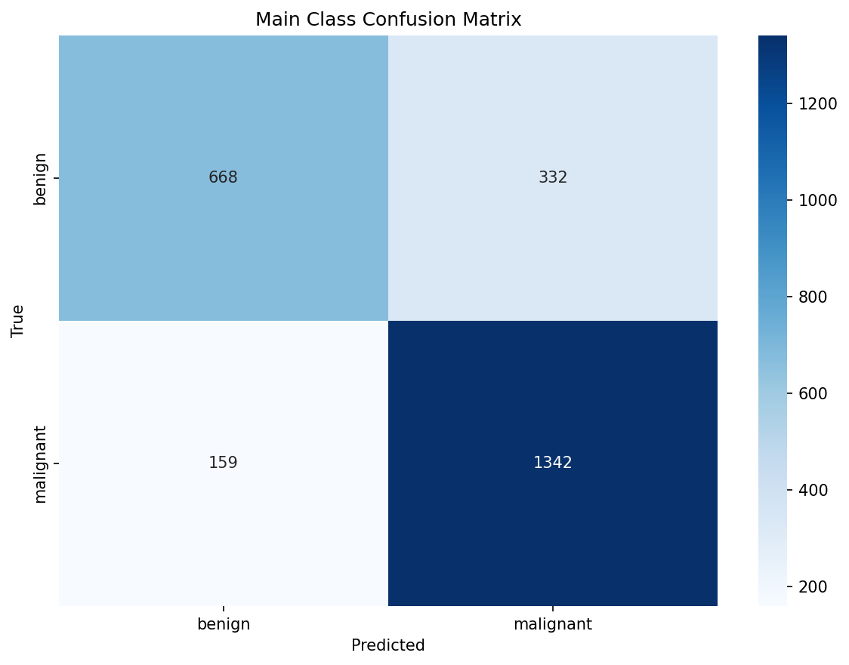
HC - Main Class Classification Results

Slide 23
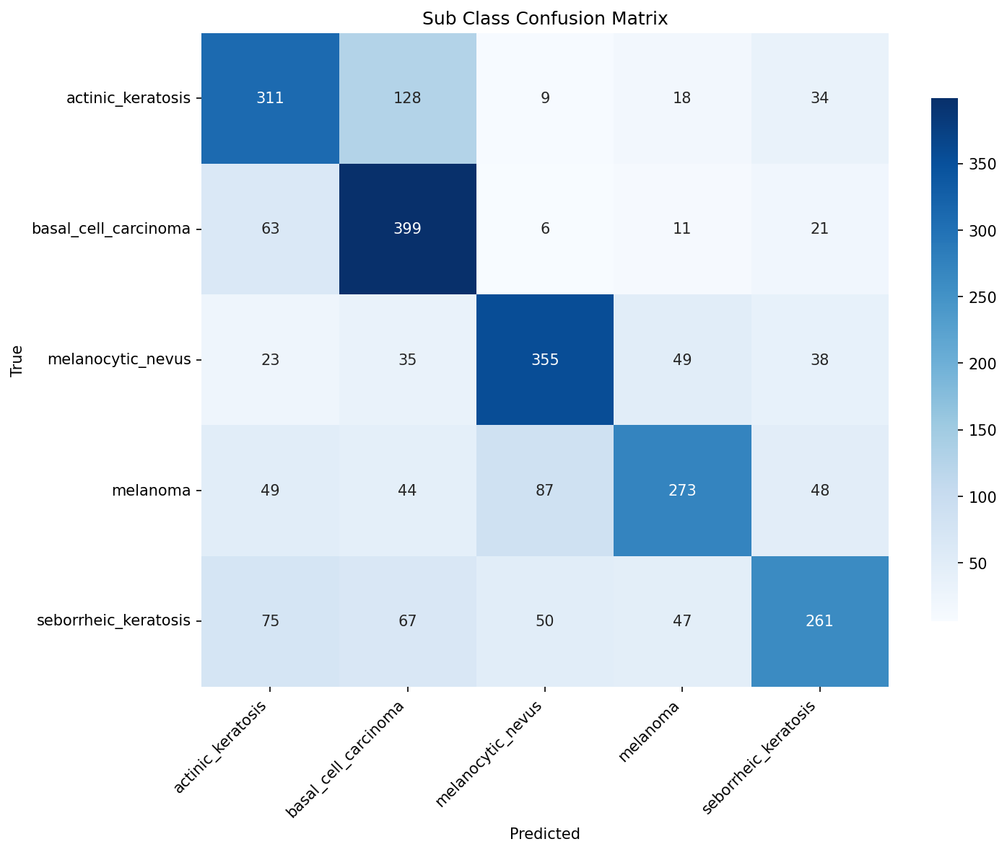
HC - Subclass Classification Results

Slide 24
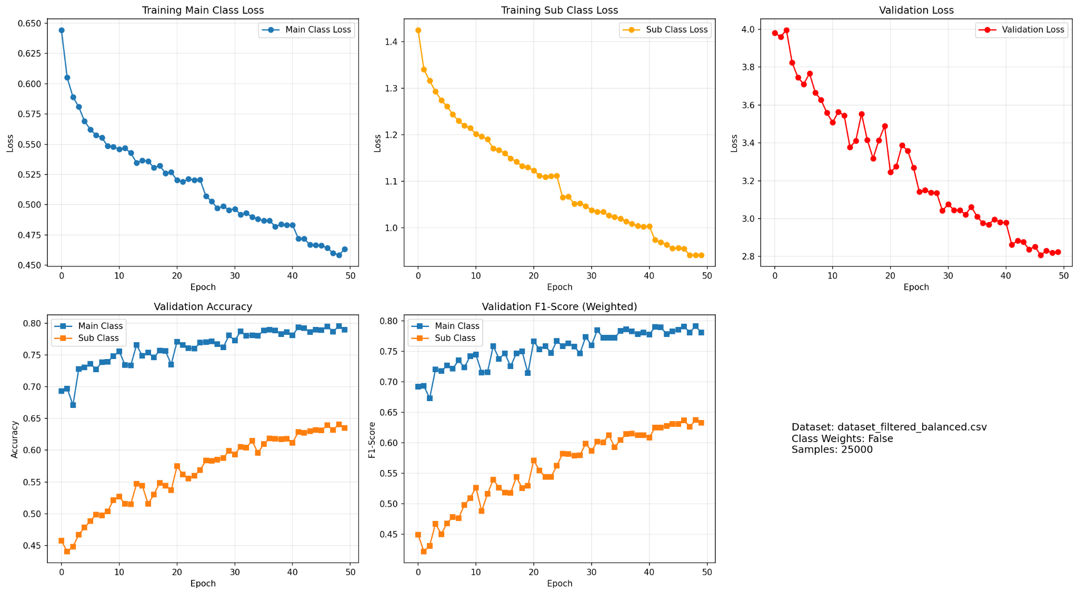
HC - Training and Validation Performance

Slide 25
Stages of Project V - MedProc
Model | BioBERT
Inputs | Medical History (Text) + Medical Report(size <= 5MB)
Output | JSON Value(Symptoms+Suggestion + E Value)
Task | Extract relevant clinical info from reports.
Evaluation Metrics | NER F1: 0.8742–0.8934 | ECE: 0.0201 Relation AUC-ROC: 0.8934 | MAE: 0.1547
Paper | https://academic.oup.com/bioinformatics/article/36/4/1234/5566506
Medical Text
Medical Report <= 5MB
Preproc: OCR(PDF) Cleanup + Tokenization <=512 tokens
BioBERT
Clinical NLP
Task: Entity & Evolution Extraction
Output: JSON (symptoms + treatment + E value)

Slide 26
Stages of Project VI – IT Fusion (Image + Text)
Model | MARIA (Multimodal Attention Resilient to Incomplete datA)
Inputs | Derm1M (413K) + MM-SkinQA (11K) + PAD-UFES-20 (2.3K) → 415,508 labelled pairs 288-dim image (EfficientFormerV2-S2) + 768-dim text (Bio_ClinicalBERT) features
Output | Risk JSON (class, ABCDE, risk score, evidence
Task | Align multimodal features (image + text)
Evaluation Metrics | Test Accuracy: 66.3% (51 classes, 415K samples) Weighted F1: 0.675 | Macro F1: 0.533 | Gate: 0.511/0.489
Paper | Caruso et al., Computers in Biology and Medicine, 196, 2025 (doi:10.1016/j.compbiomed.2025.110843)
MedProc JSON
HC Output (Class + ABCDE)
Preproc: Feature Alignment
MARIA Model
Task: Image-Text Fusion
[ Insert: Gate Weight Bar Chart ]
Image gate: 0.511 ± 0.184 | Text gate: 0.489 ± 0.184
Output: Risk JSON (score + evidence)

Slide 27
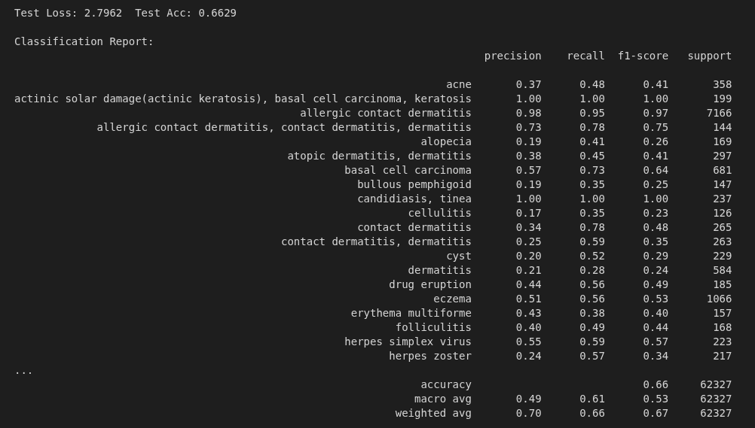
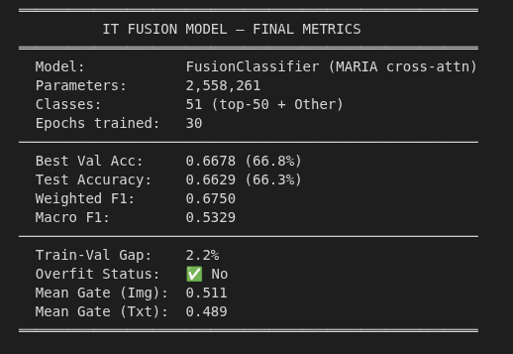
IT Fusion – Results Summary
Model: FusionClassifier (MARIA cross-attn)
Parameters: 2,558,261
Classes: 51 (top-50 + Other)
Epochs trained: 30 | Best epoch: 20
Test Performance
Test Accuracy: 66.3%
Best Val Acc: 66.8%
Test Loss: 2.7962
Weighted F1: 0.6750
Macro F1: 0.5329
Modality Gate Weights
Mean Image gate: 0.511 ± 0.184
Mean Text gate: 0.489 ± 0.184
Train-Val Gap: 2.2% (no overfitting)
Dataset
Total samples: 415,508
Derm1M: 413,210 | MM-Skin: 11,090
PAD-UFES-20: 2,298

Slide 28
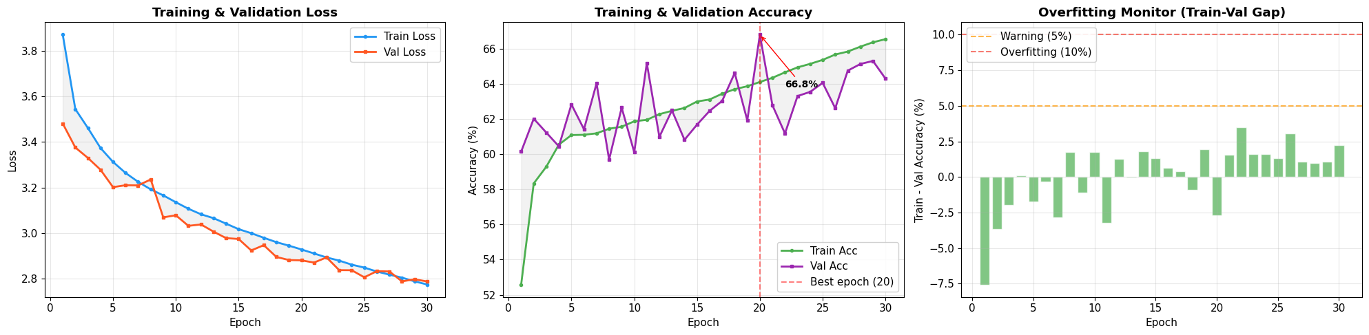
IT Fusion – Training Curves
Key Observations:
► Loss converges smoothly — both train and val loss decrease consistently over 30 epochs.
► Best val accuracy 66.8% reached at epoch 20; model saved at checkpoint.
► Train-Val gap stays below 5% warning threshold — no overfitting detected.

Slide 29
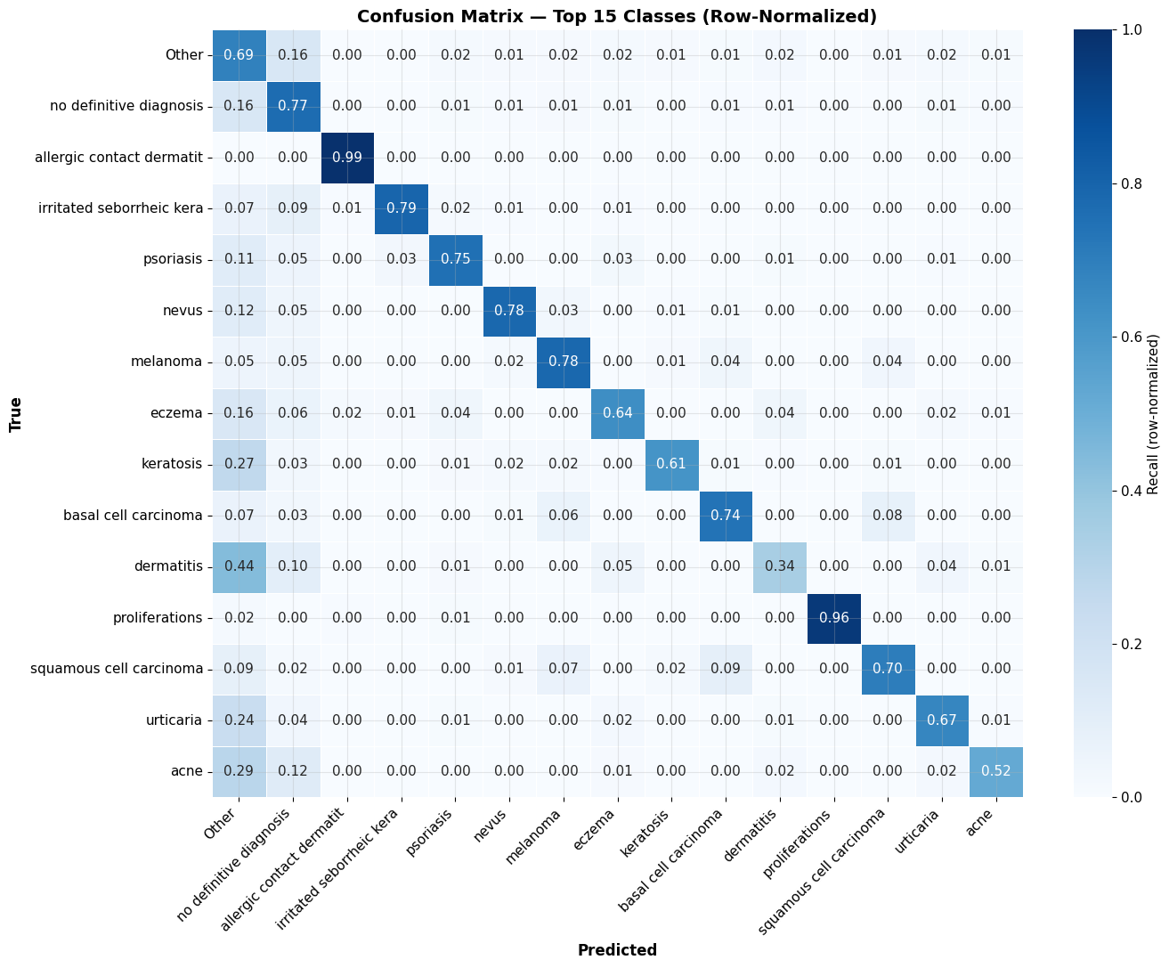
IT Fusion – Confusion Matrix (Top 15 Classes)
Strong Classes
Allergic contact dermatitis: 0.99
Proliferations: 0.96
No definitive dx: 0.77
Melanoma: 0.78
Nevus: 0.78
Challenging Classes
Dermatitis: 0.34 (confused with Other)
Cellulitis: 0.23
Bullous pemphigoid: 0.25
Insight
Visually-distinct, high-support classes perform best. Low-support overlapping classes remain challenging — expected for Derm1M-scale noisy labels.

Slide 30
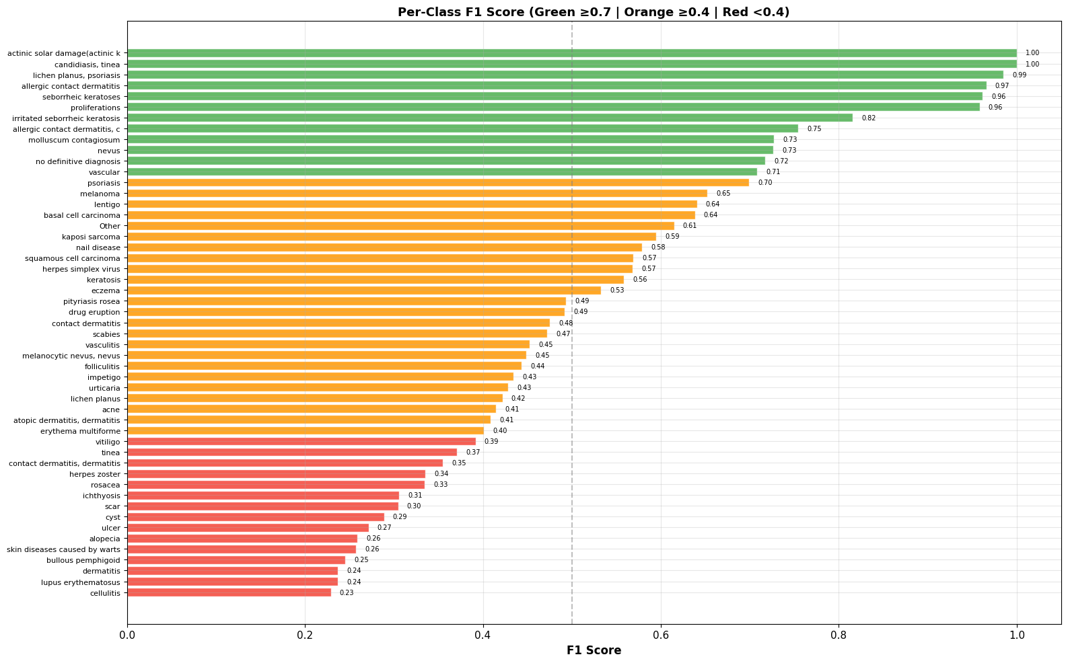
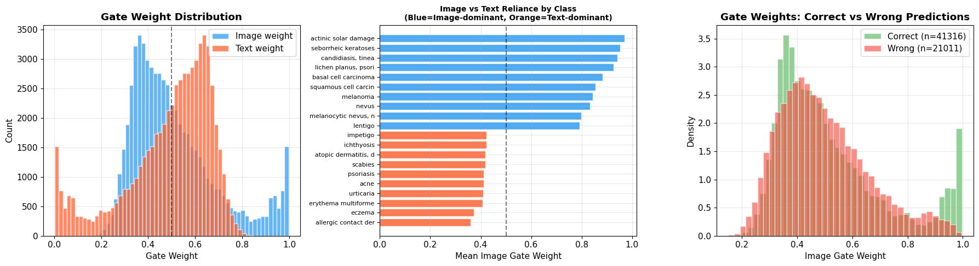
IT Fusion – Per-Class F1 & Modality Gate Analysis
Per-Class F1 Score (51 classes)
Modality Gate Weight Analysis

Slide 31
Stage 7: VQA – R-LLaVA with QLoRA
Model
LLaVA-v1.6-Mistral-7B + QLoRA (r=8, NF4 4-bit)
[ Insert: VQA Pipeline Diagram (ROI -> R-LLaVA -> Answer) ]
Inputs
ROI Image (336x336) + IT Fusion JSON + Question
Output
Clinical answer + ABCDE evidence + drug recommendation
Dataset
Stage6QA: 415K pairs | 4 types | 6 disease classes
Training
Stage I: VICReg projector | Stage II: LoRA q/k/v/o_proj
Hardware
DGX 3xA100-SXM4-40GB | 126 GB VRAM | CUDA 12.2
Config
7 epochs | batch=4 | LR=2e-5 | grad_accum=4 | patience=5
Sample Q&A (ABCDE-grounded)
Q: What ABCDE features indicate malignancy risk?
A: Asymmetry=0.87 (high), Border=0.74 (irregular),
Color=0.63 (multicolor), Diameter=0.55 (>6mm),
Evolution=0.72 (changing) -> High risk -> MEL
Drug: Refer immediately for biopsy + excision.
Paper
Chen et al., R-LLaVA, arXiv:2410.20327 (ICLR 2025)

Slide 32
Stage 7 VQA – Dataset Pipeline (Stage6QA)
Dataset Construction Pipeline
QA Type Distribution
Step 1
Load 415,508 IT Fusion pairs (Derm1M + MM-Skin + PAD-UFES-20)
Type
Templates
Count
Example question
Step 2
Perceptual hash deduplication across all images
Open
5
~138K
What is the diagnosis?
Step 3
ARCUNet mask generation -> SLRC ROI crop (224x224)
Close
4
~110K
Is this lesion malignant?
Step 4
BBoxResolver 5-priority fallback: SLRC > Stage3 > mask centroid
Region
3
~83K
Describe the lesion region
Step 5
ABCDE risk scoring: A=asymmetry, B=border, C=color, D=diam, E=evol
Multichoice
3
~83K
Which matches: MEL/BCC/NEV?
Step 6
Apply 15 QA templates -> generate question-answer pairs
TOTAL
15
~415K
4 disease-grounded types
Step 7
Optional Llama 3.1 paraphrasing via Ollama (cached)
Dataset stats:
Train: 332K | Val: 41K | Test: 41K (patient-grouped, no leakage)
Dedup: perceptual hash | SKIP_EXISTING=True | resume-safe
Step 8
80/10/10 patient-grouped split -> parquet output

Slide 33
Stage 7 VQA – R-LLaVA Training Architecture
Stage I: Projector Pretraining
Stage II: QLoRA Fine-tuning
Goal
Align CLIP vision features with LLM embedding space
Goal
Fine-tune on Stage6QA for ABCDE-aware VQA
Loss
VICReg: variance + covariance regularization
LoRA
r=8, alpha=16, dropout=0.0 | targets: q/k/v/o_proj
Trains
multi_modal_projector only (10.5M params, dequant to fp16)
Quant
NF4 4-bit base + fp16 LoRA adapter weights
Data
331K unique dermoscopy images (no captions needed)
Training
7 epochs | LR=2e-5 | batch=4 | grad_accum=4
Time
~20 min / epoch on 3xA100 | 3 epochs total
Early stop
patience=5 epochs | best checkpoint saved
Output
projector.pt (~40 MB) saved to stage1_best/
Output
adapter_model.safetensors (~25 MB) for inference
Key config: TOKENS_PER_PATCH=584 | IMG_SIZE=336 | seq_len=2048 | GRID_PINPOINTS=5 | device_map=auto
Inference loading: Base model -> Stage I projector.pt -> Stage II LoRA (must train Stage II with Stage I loaded)
RAG: ChromaDB + all-MiniLM-L6-v2 | DermNet + StatPearls + MedQuAD | top-k=3 | threshold=0.25

Slide 34
Stage 7 VQA – Training Graphs & Metrics
[ Training Loss (Stage II LoRA, per step) ]
[ Validation Loss (per epoch) ]
Graphs to insert:
Training_Loss.png
Validation_Loss.png
BLEU_4_Progression.png
ROUGE_L_Progression.png
METEOR_Progression.png
Exact_Match_Progression.png
Recall_at_K.png
Context_Retention.png
Target metrics:
BLEU-4 > 0.15
ROUGE-L > 0.25
METEOR > 0.20
EM close > 60%
Recall@K > 0.70
[ BLEU-4 Progression (per epoch) ]
[ ROUGE-L Progression (per epoch) ]

Slide 35
Stage 7 – RAG Pipeline (Retrieval-Augmented Generation)
What is RAG?
Knowledge Base (ChromaDB)
R-LLaVA is a 7B VQA model — it can hallucinate on clinical questions
without grounding. RAG grounds answers in real dermatology evidence
retrieved at query time from ChromaDB, not baked into weights.
statpearls/
6 files — MEL, BCC, SCC, ACK, SEK, NEV clinical summaries
abcde_guidelines/
2 files — AAD ABCDE rule + ABCD dermoscopy criteria
1
Question Router classifies query
Routing: diagnosis -> DermNet | abcde -> AAD guidelines | treatment -> AAD | risk -> AAD
aad_guidelines/
3 files — MEL, BCC, SCC treatment guidelines
2
DermatologyRAG embeds query
all-MiniLM-L6-v2 (384-dim) encodes question -> cosine similarity search in ChromaDB
dermnet/
6 files — DermNet disease descriptions per class
medquad/
~300 files — MedQuAD XML parsed dermatology QA pairs
3
Top-k chunks injected into prompt
Top-3 chunks above threshold=0.25 prepended to R-LLaVA context window
Config:
Embedding: all-MiniLM-L6-v2 (384-dim, CPU)
Chunk: 350 words | overlap: 60 | min: 40 chars
Top-k: 3 | Similarity threshold: 0.25 | cosine distance
4
LlamaReasoner synthesises evidence
Llama 3.1 (8B via Ollama): 2-3 sentence reasoning summary from RAG + rules engine

Slide 36
Stage 7 – RAG Evaluation Metrics
RAG Retrieval Metrics (to be computed)
Graphs — Insert after evaluation
Metric
Definition
Target
Result
[ Precision@K vs K curve ]
[ Recall@K vs K curve ]
Precision@K
Fraction of retrieved chunks that are relevant
>0.70
—
Recall@K
Fraction of relevant chunks that are retrieved
>0.65
—
MRR
Mean Reciprocal Rank of first relevant chunk
>0.75
—
[ Answer Faithfulness per Q-type ]
[ Hit Rate per source filter ]
Hit Rate
% queries with at least 1 relevant chunk
>0.80
—
Answer Faithfulness
Answer grounded in retrieved context?
>0.75
—
Latency
End-to-end retrieval time per query
<100ms
—
Sample RAG-grounded answer snippet
Question Routing -> RAG Source Filter
Q: What treatment is recommended for high-risk melanoma?
[Retrieved: aad_guidelines | score=0.87]
Wide local excision with 1-2cm margins is recommended for
melanoma >1mm Breslow depth. Sentinel lymph node biopsy
is indicated. Adjuvant immunotherapy for Stage III/IV.
Rules engine: MEL | risk=HIGH | A=0.87 -> Refer to dermatologist
diagnosis
dermnet
DermNet disease pages
abcde
abcde_guidelines
AAD ABCDE + ABCD rule
risk
aad_guidelines
AAD risk + treatment guidelines
treatment
aad_guidelines
AAD surgery + excision guidelines
general
None (all sources)
Unfiltered cosine search

Slide 37
Stagewise Datasets
Stages | Datasets required
SLS | ISIC 2016,2017,2018, PH2
ROI Cropping | No dataset required
HC | ISIC 2019,ISIC 2018, MILK10k
MedProc | MIMIC-III, MIMIC-IV, PAD-UFES-20, EICU, Derm1M
IT Fusion | Derm1M (413K) + MM-SkinQA (11K) + PAD-UFES-20 (2.3K) → 415,508 labelled pairs, 51 classes
VQA | Stage6QA: 415K pairs from Derm1M+MM-Skin+PAD-UFES | 4 types: open/close/region/multichoice | RAG: MedQuAD+DermNet+StatPearls

Slide 38
Development
Preprocessing Image Resize/ OCR
Output: Cleaned data
SLS (ARCUNet)
Input Image: 512x512
Output: Lesion Mask
SLRC (OpenCV + Connected Components)
Input: Image + Mask
Output: ROI Crop 224 x 224
HC EfficientFormerV2-s
Input: ROI Crop
Output: Lesion Class + ABCD
VQA (R-LLaVA)
Input: Question + ROI +JSON
Output: Answer + Evidence
IT Fusion (MARIA)
Input: HC + MedProc
Output: Risk JSON (ABCDE + Evidence)
MedProc (BIOBert)
Input: Text <= 512 tokens
Output: Entities + E

Slide 39
Experimental Setup & Preprocessing
Image size: 224×224 / 512×512.
Text: ≤512 tokens.
Hardware: NVIDIA GPU, PyTorch, FastAPI, React.
Preprocessing: Hair removal, OCR for PDF, Tokenization.

Slide 40
Project Timeline
S1
S2
S3
S4
JUNE
JULY
AUG
SEPT
OCT
NOV
DEC
JAN
FEB
MARCH
APRIL
MAY
JUNE
Topic Selection
Literature Survey
Dataset Collection
Stage 1: Preprocessing
Stage 2: SLS
Stage 3: SLRC
Stage 4: MedProc
Stage 5: HC
Stage 6: IT Fusion
Stage 7: VQA
Integration Testing
Frontend Development
Backend + Frontend Integration
Final Evaluation
Thesis Writing
Thesis Defense

Slide 41
Stagewise Results Summary
Stage6QA: open/close/region/multichoice QA | TOKENS_PER_PATCH=584 | batch=4 | 7 epochs planned
SLS (Segmentation): Dice 0.8506 | IoU 0.7718 | Boundary F1 0.8815 | Pixel Acc 93.7%
HC (Classification): Binary Acc 94.7% | 7-Class Acc 89.2% | W-F1 0.8876 | AUC 0.9751
MedProc (NLP): NER F1 0.87–0.89 | Relation AUC 0.8934 | ECE 0.0201
IT Fusion (MARIA): Test Acc 66.3% | W-F1 0.675 | Macro F1 0.533 | Gate 0.511/0.489
VQA (R-LLaVA + QLoRA): 415K QA pairs built; Stage I projector trained; Stage II LoRA training on DGX 3×A100

Slide 42
Conclusion & Limitations
Contributions: Six validated stages (SLS, SLRC, HC, MedProc, IT Fusion, VQA dataset); multimodal ABCDE explainability; 415K Stage6QA pairs built; R-LLaVA Stage I+II training underway on DGX 3×A100.
Advantages: End-to-end modular pipeline; Dice 0.8506 (SLS), 94.7% binary accuracy (HC), W-F1 0.675 (IT Fusion); structured Clinical JSON with evidence trail.
Limitations: VQA Stage II LoRA fine-tuning in progress (expected ~20h on 3×A100); Stage 6 uses 2-modality FusionClassifier; skin-tone bias in Derm1M; English-only NLP; stateless inference without long-term memory.

Slide 43
Comparative Analysis
NutriDermAI is the first pipeline to compute clinically-calibrated ABCDE scores via principled image-text fusion across five validated stages.
SLS: IoU 0.7718, Dice 0.8506 — competitive with recent ARC-UNet, ESC-UNet, ScaleFusionNet variants.
HC: 94.7% binary accuracy, AUC 0.9751 — EfficientFormerV2-S2 outperforms standard ResNet/ViT baselines on HAM10000+ISIC.
IT Fusion: MARIA masked cross-attention achieves balanced modality gate (0.511/0.489) — avoids single-modality collapse seen in naive fusion baselines.

Slide 44
Future Work
Complete VQA fine-tuning (R-LLaVA + QLoRA on Stage6QA dataset); benchmark BLEU-4, ROUGE-L, METEOR, Exact Match.
Prospective clinical validation of ABCDE scores vs. board-certified dermatologist consensus; fairness audits across skin tones (Fitzpatrick I–VI).
Deploy 5-modality MARIA orchestrator; benchmark Stage 6 live-pipeline latency; extend to multilingual clinical NLP; real-time mobile deployment.

Slide 45
Demo (Prototype)
Frontend chatbot allows patient to upload image & report.
Patient can ask a question.
System outputs ABCDE values + risk assessment + answer.

Slide 46
References
[1] Soni et al., “ARCUNet: enhancing skin lesion segmentation,” Scientific Reports 15, 9262 (2025).
[2] Li et al., “EfficientFormerV2: Rethinking Vision Transformers for MobileNet Size,” arXiv:2212.08059 (2023).
[3] Chen et al., “R-LLaVA: Improving Med-VQA with Visual Region of Interest,” arXiv:2410.20327, ICLR Workshop (2025).
[4] Lee et al., “BioBERT: a pre-trained biomedical language representation model,” Bioinformatics 36(4), 1234–1240 (2020).
[5] Alsentzer et al., “Publicly Available Clinical BERT Embeddings,” arXiv:1904.03323 (2019). [Bio_ClinicalBERT]
[6] Caruso et al., “MARIA: A Multimodal Transformer Model for Incomplete Healthcare Data,” Computers in Biology and Medicine, 196, 110843 (2025).
[7] Yan et al., “Derm1M: A Million-scale Vision-Language Dataset for Dermatology,” arXiv:2503.14911 (2025).

Slide 47
Thank You / Q&A
Thank You
Questions?

